Slide 1
Computer Graphics and Multimedia Systems SCS1302
Unit 1

Slide 2
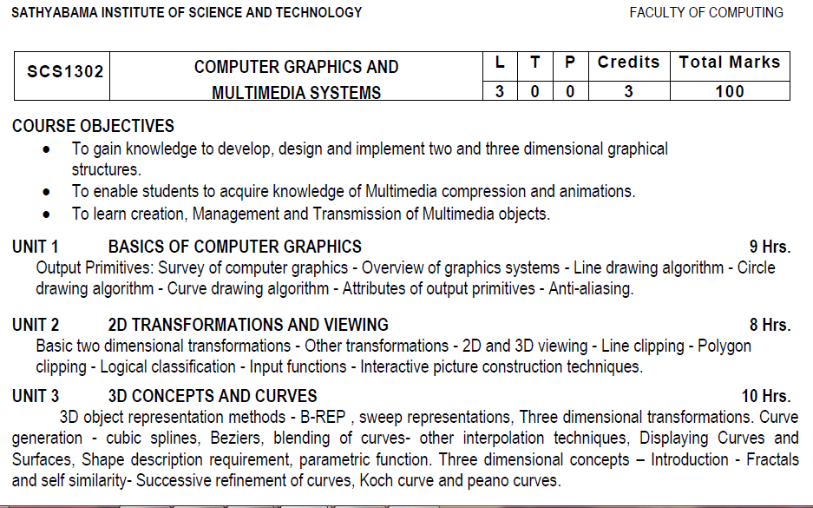
Syllabus

Slide 3
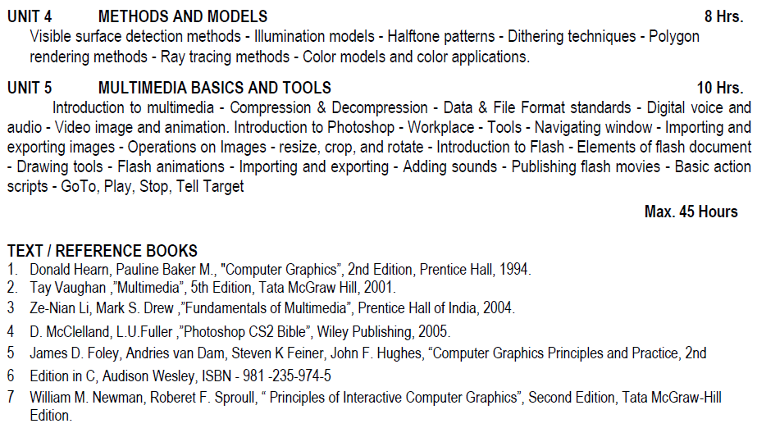
Syllabus

Slide 4
Course Objective(CO)
CO1: Construct lines and circles for the given input.
CO2: Apply 2D transformation techniques to transform the shapes to fit them as per the picture definition.
CO3: Construct splines, curves and perform 3D transformations
CO4: Apply colour and transformation techniques for various applications.
CO5: Analyse the fundamentals of animation, virtual reality, and underlying technologies.
CO6: Develop photo shop applications

Slide 5
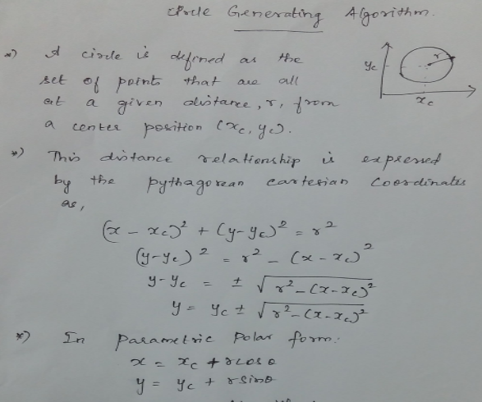
CIRCLE DRAWING ALGORITHM

Slide 6
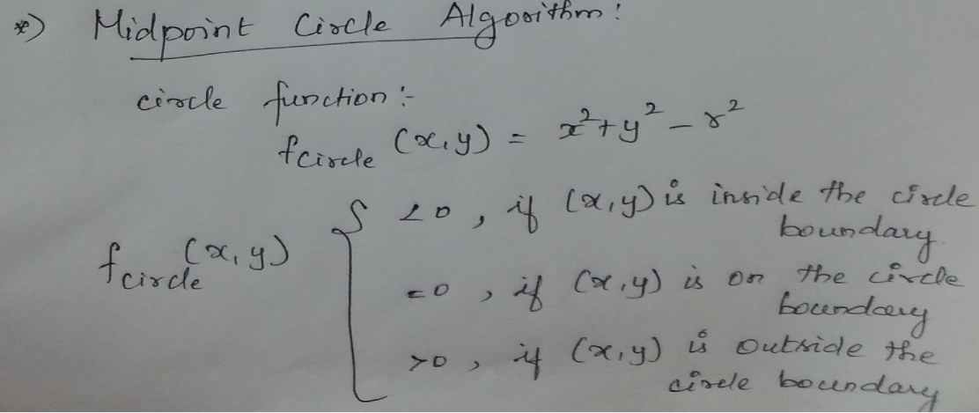

Slide 7
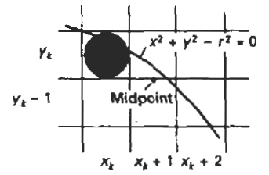
Midpoint Circle drawing algorithm

Slide 8
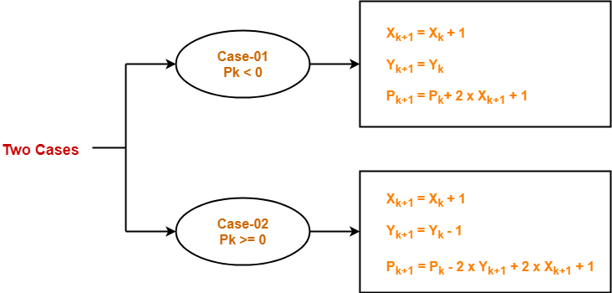

Slide 9
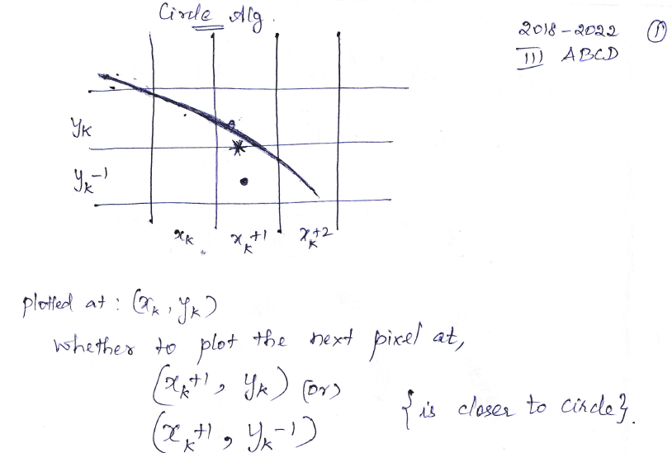
Midpoint Circle drawing algorithm

Slide 10
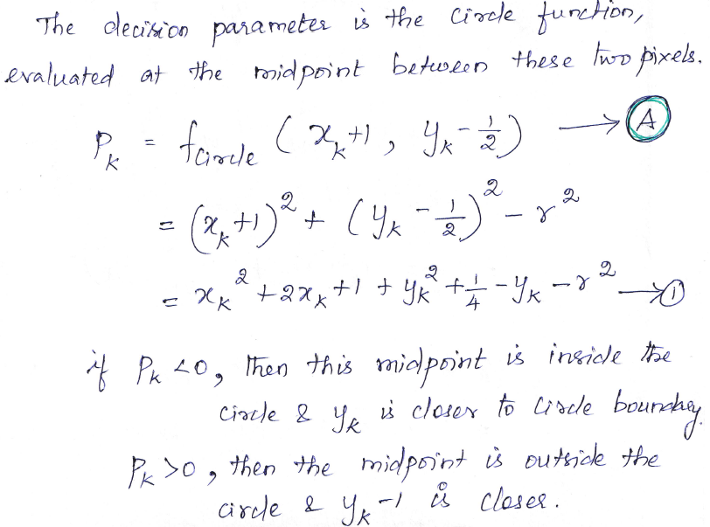
Midpoint Circle drawing algorithm

Slide 11
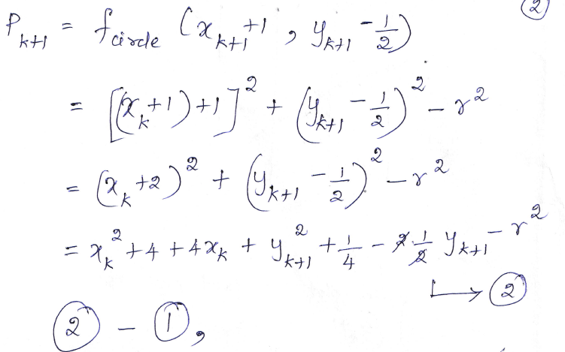
Midpoint Circle drawing algorithm

Slide 12
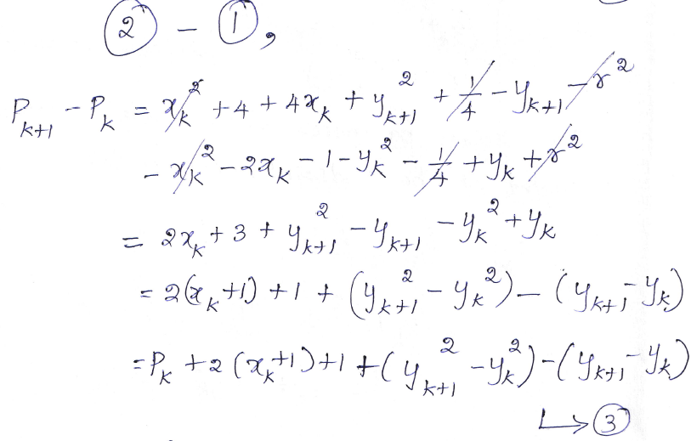
Midpoint Circle drawing algorithm

Slide 13
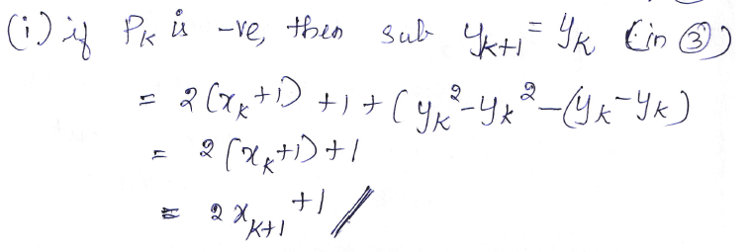
Midpoint Circle drawing algorithm

Slide 14
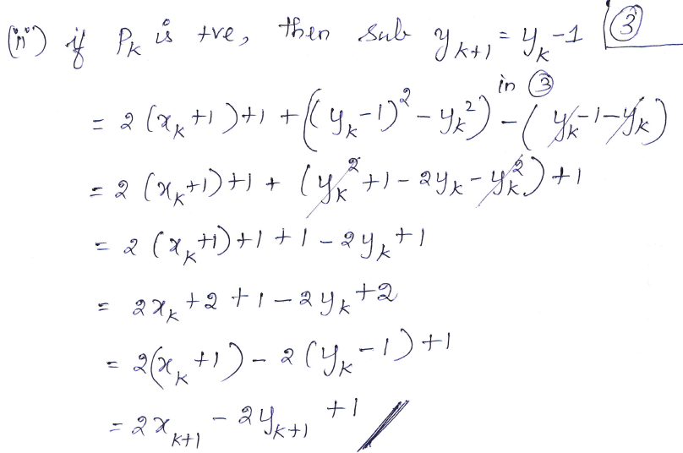
Midpoint Circle drawing algorithm

Slide 15
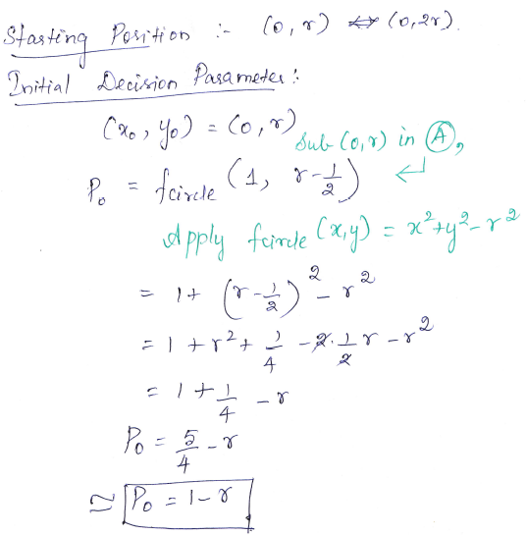
Midpoint Circle drawing algorithm

Slide 16
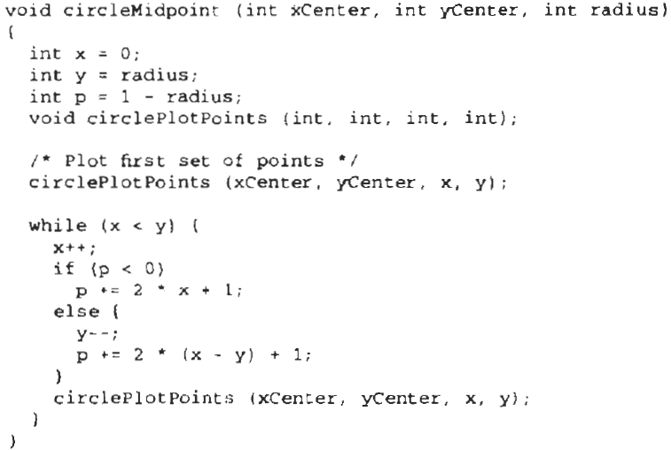
Midpoint Circle drawing algorithm

Slide 17
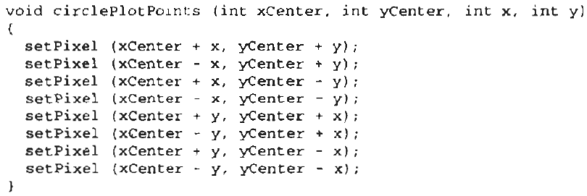
Midpoint Circle drawing algorithm

Slide 18
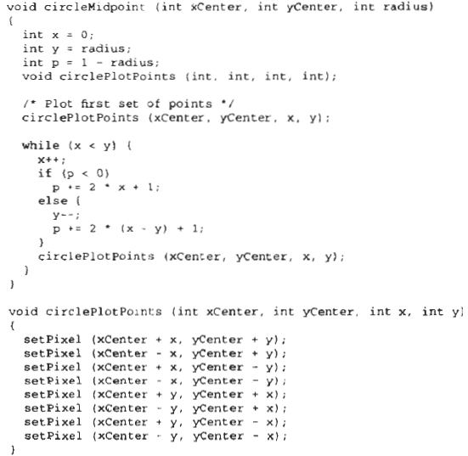
Midpoint Circle drawing algorithm

Slide 19
Midpoint Circle drawing algorithm
Example:
Given (xc,yc)=(0,0), x=0 and radius, r=10.
Generate a circle using Midpoint Circle drawing algorithm.

Slide 20
Given xc=yc=0, radius, r=10.
Solution:
x=0; y=10;
p=1-r
=1-10
=-9
circlepoints(0,0,0,10)
{
Setpixel(0+0,0+10) =(0,10)
Setpixel(0-0,0+10) =(0,10)
Setpixel(0+0,0-10) =(0,-10)
Setpixel(0-0,0-10) =(0,-10)
Setpixel(0+10,0+0) =(10,0)
Setpixel(0-10,0+0) = (-10,0)
Setpixel(0+10,0-0) =(10,0)
Setpixel(0-10,0-0) = (-10,0)
}
While(0<10)
{x=1
If(-9 <0)
P=p+2*x+1 = -9+2*1+1 = -9+2+1
=-6
}
circlepoints(0,0,1,10)
{
Setpixel(0+1,0+10) =(1,10)
Setpixel(0-1,0+10) =(-1,10)
Setpixel(0+1,0-10) =(1,-10)
Setpixel(0-1,0-10) =(-1,-10)
Setpixel(0+10,0+1) =(10,1)
Setpixel(0-10,0+1) = (-10,1)
Setpixel(0+10,0-1) =(10,-1)
Setpixel(0-10,0-1) = (-10,-1)
}

Slide 21
Example: Midpoint Circle drawing algorithm
Iteration 2:
While(1<10)
{x=2
If(-6 <0)
P=p+2*x+1 = -6+2*2+1 = -6+4+1
=-1
}
circlepoints(0,0,2,10)
{
Setpixel(0+2,0+10) =(2,10)
Setpixel(0-2,0+10) =(-2,10)
Setpixel(0+2,0-10) =(2,-10)
Setpixel(0-2,0-10) =(-2,-10)
Setpixel(0+10,0+2) =(10,2)
Setpixel(0-10,0+2) = (-10,2)
Setpixel(0+10,0-2) =(10,-2)
Setpixel(0-10,0-2) = (-10,-2)
}
Iteration 3:
While(2<10)
{x=3
If(-1 <0)
P=p+2*x+1 = -1+2*3+1 = -1+6+1
=6
}
circlepoints(0,0,3,10)
{
Setpixel(0+3,0+10) =(3,10)
Setpixel(0-3,0+10) =(-3,10)
Setpixel(0+3,0-10) =(3,-10)
Setpixel(0-3,0-10) =(-3,-10)
Setpixel(0+10,0+3) =(10,3)
Setpixel(0-10,0+3) = (-10,3)
Setpixel(0+10,0-3) =(10,-3)
Setpixel(0-10,0-3) = (-10,-3)
}

Slide 22
Example: Midpoint Circle drawing algorithm
Iteration4:
While(3<10)
{x=4
If(6 <0)
Else
y=y-1 = 9
P=p+2*(x-y)+1 = 6+2*(4-9)+1 = 6 +2(-5) +1 = 6 -10 +1
=-3
}
circlepoints(0,0,4,9)
{
Setpixel(0+4,0+9) =(4,9)
Setpixel(0-4,0+9) =(-4,9)
Setpixel(0+4,0-9) =(4,-9)
Setpixel(0-4,0-9) =(-4,-9)
Setpixel(0+9,0+4) =(9,4)
Setpixel(0-9,0+4) = (-9,4)
Setpixel(0+9,0-4) =(9,-4)
Setpixel(0-9,0-4) = (-9,-4)
}

Slide 23
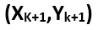
RESULTANT POINTS
0 | -9 | (1,10)
1 | -6 | (2,10)
2 | -1 | (3,10)
3 | 6 | (4,9)
4 | -3 | (5,9)
5 | 8 | (6,8)
6 | 5 | (7,7)

Slide 24
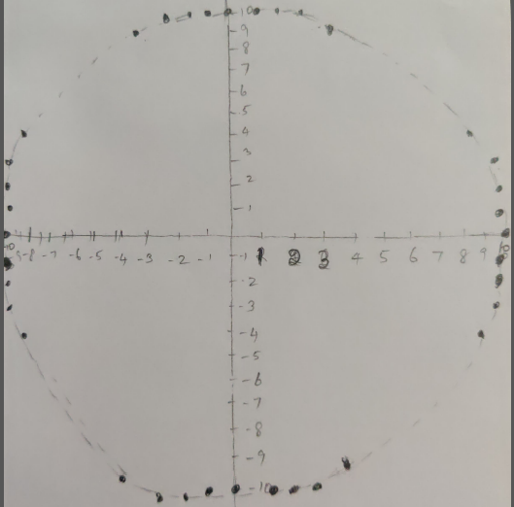

Slide 25
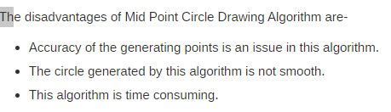
Disadvantages of Mid Point Circle Drawing Algorithm-

Slide 26
Advantages of Mid Point Circle Drawing Algorithm-
The advantages of Mid Point Circle Drawing Algorithm are-
It is a powerful and efficient algorithm.
The entire algorithm is based on the simple equation of circle X² + Y² = R².
It is easy to implement from the programmer’s perspective.
This algorithm is used to generate curves on raster displays.

Slide 27
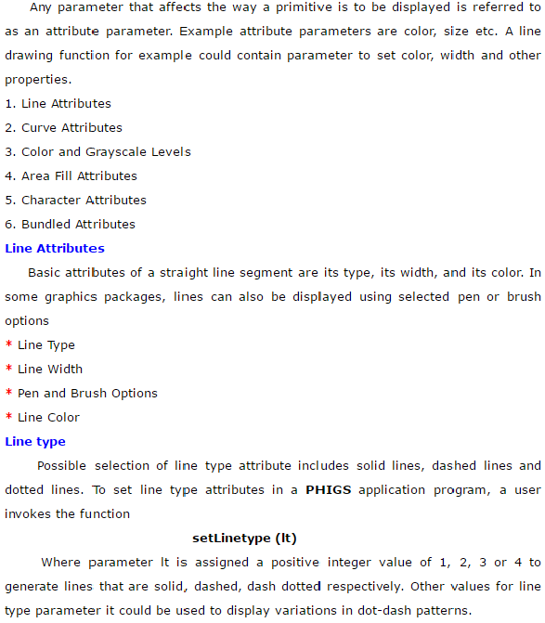
Attributes of Output Primitives

Slide 28
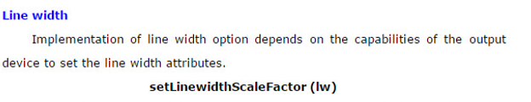
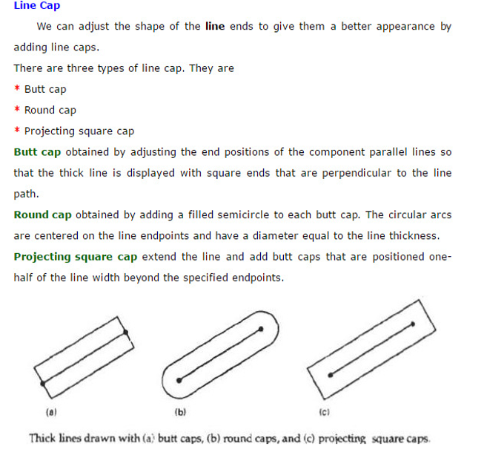

Slide 29
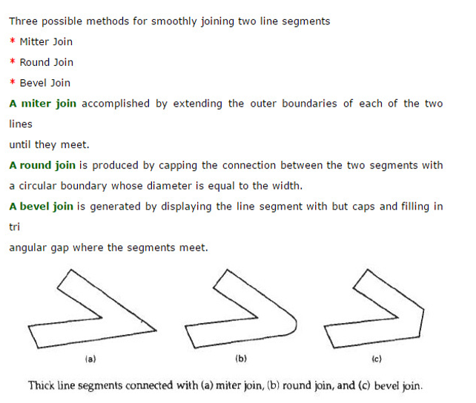

Slide 30
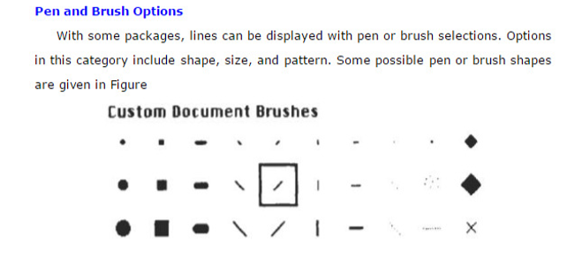
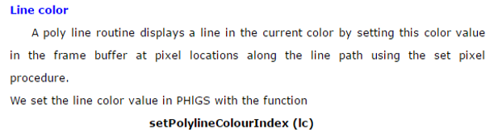

Slide 31
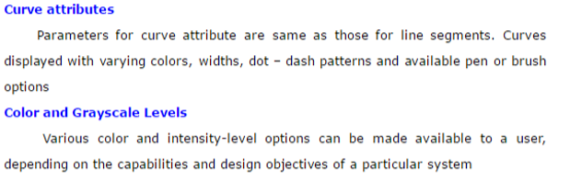
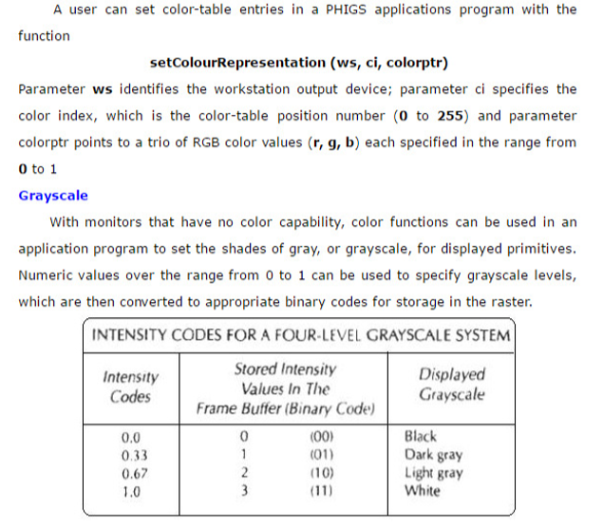

Slide 32
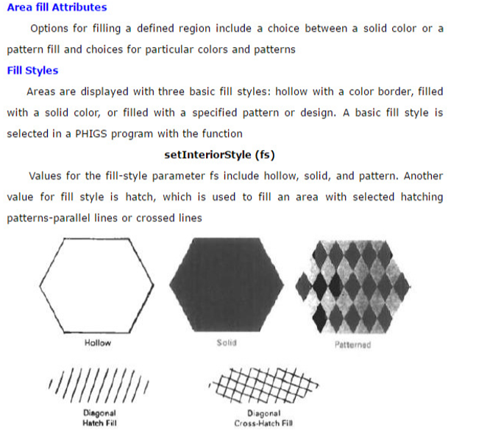

Slide 33
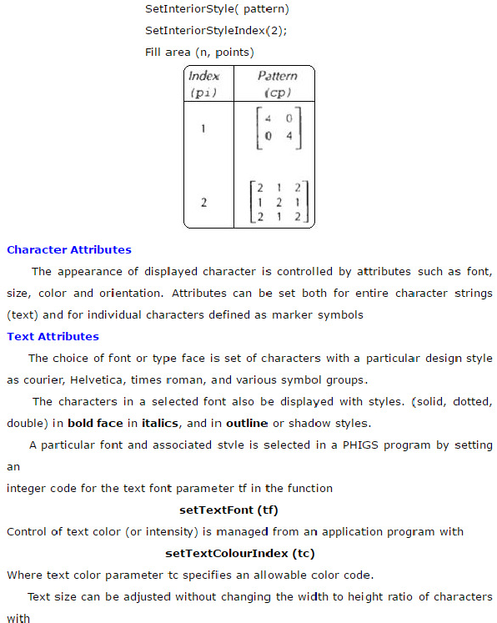

Slide 34
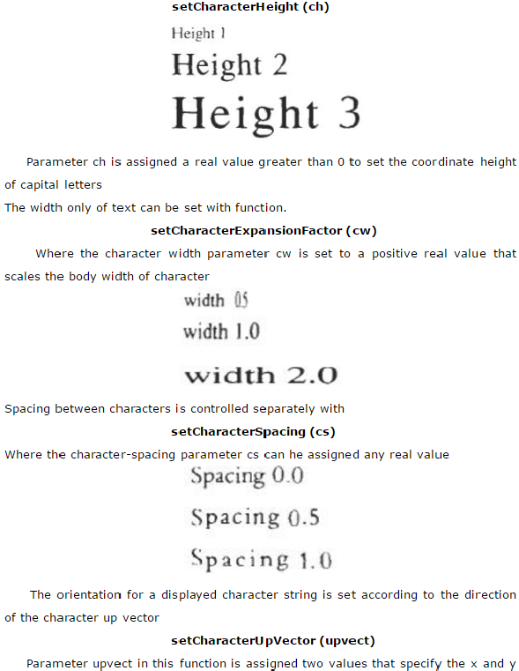

Slide 35
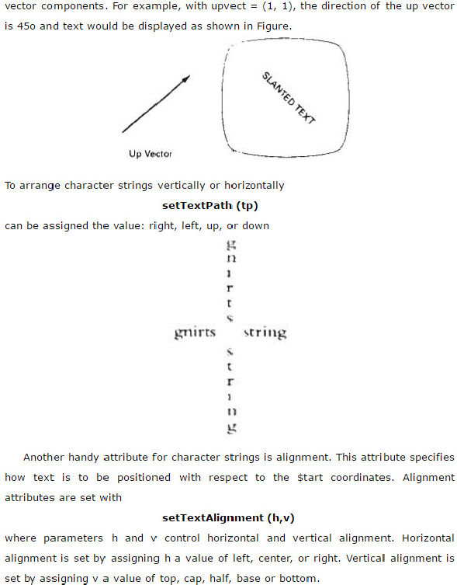

Slide 36
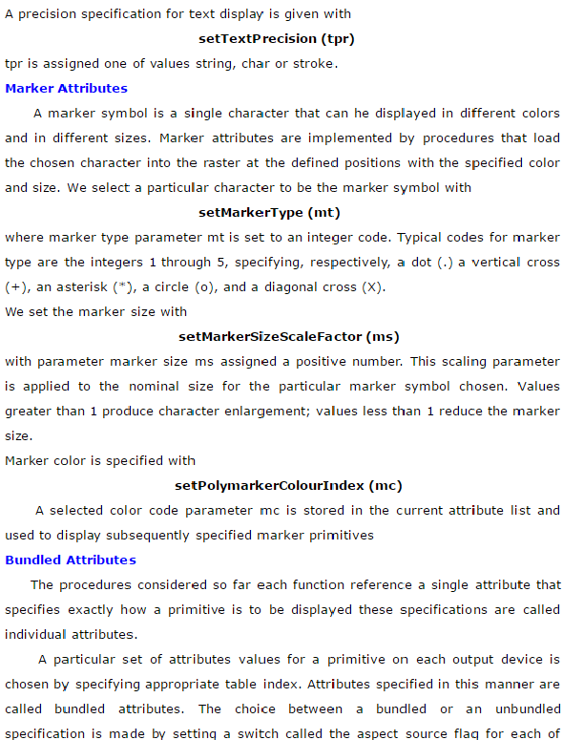

Slide 37
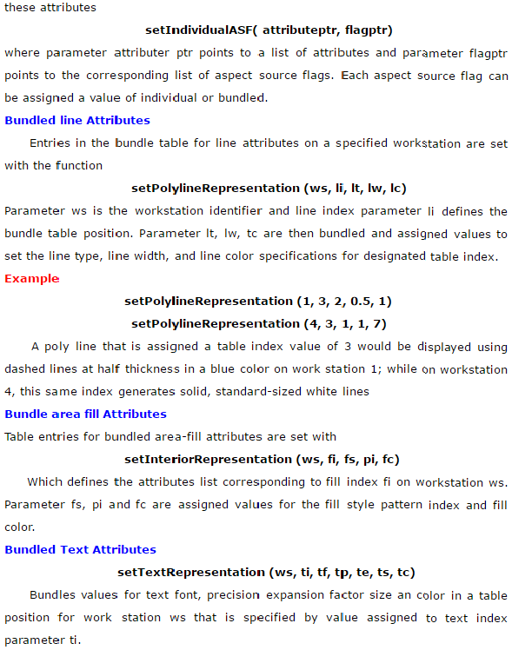

Slide 38
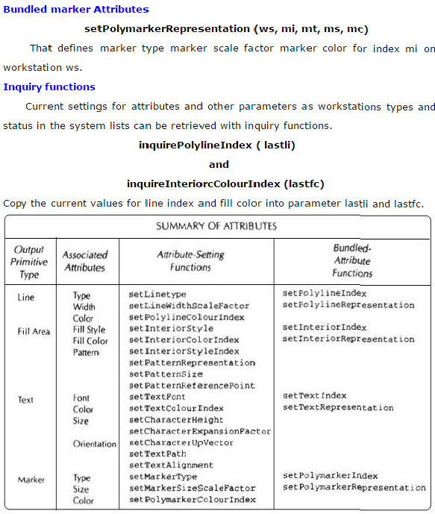

Slide 39
Antialiasing
Antialiasing is the smoothing of the image or sound roughness caused by aliasing .
With images, approaches include adjusting pixel positions or setting pixel intensities so that there is a more gradual transition between the color of a line and the background color.
With sound, aliases are removed by eliminating frequencies above half the sampling frequencies.

Slide 40
Side effects of Scan Conversion
The most common side effects when working with raster devices are:
Unequal Intensity
Overstrike
- Aliasing
Unequal Intensity
Human perception of light is dependent on density and intensity of light source.
Solution: By increasing the number of pixels on diagonal lines.
Overstrike:
The same pixel is written more than once.
This results in intensified pixels in case of photographic media, such as slide or transparency.
Solution: Check each pixel to see whether it has already been written to prior to writing a new point.

Slide 41
Aliasing
The effect created when rasterization is performed over a discrete series of pixels.
In particular, when lines or edges do not necessarily align directly with arrow or column of pixels, that line may appear unsmooth and have a stair-step edge appearance.
Jagged appearance of curves or diagonal lines on a display screen, which is caused by low screen resolution.
Refers to the plotting of a point in a location other than its true location in order to fit the point into the raster.
Consider equation Y=mX+b, For m=0.5, b=1, X=3
Y would be 2.5. So the point (3, 2.5) is plotted at alias location (3,3).

Slide 42

Anti-Aliasing
The image on the right shows the result of anti-aliasing through the use of high r resolution.

Slide 43
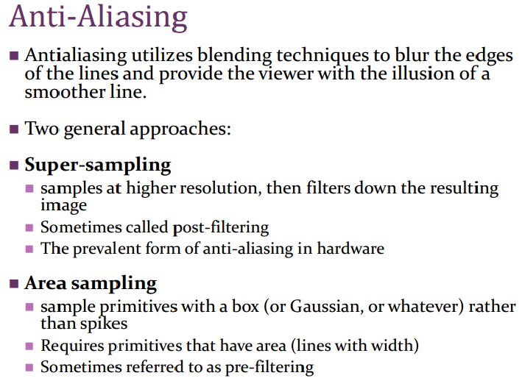

Slide 44
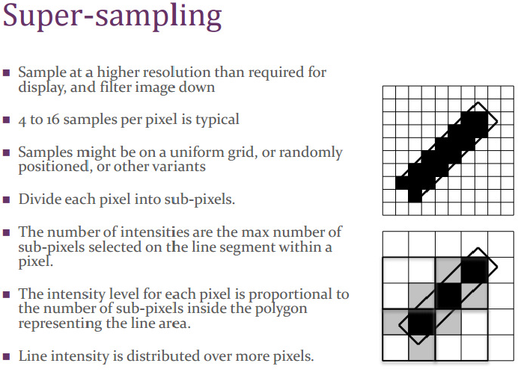

Slide 45
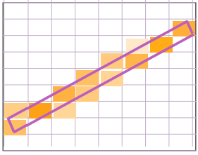
Area Sampling
Determine the percentage of area coverage for a screen pixel, then set the pixel intensity proportional to this percentage.
Consider a line as having thickness.
Consider pixels as little squares.
Unweighted area sampli by the line.
eg: Fill pixels according to the proportion of their square covered
Weighted area sampling: Weight the contribution according to where in the square the primitives falls

Slide 46
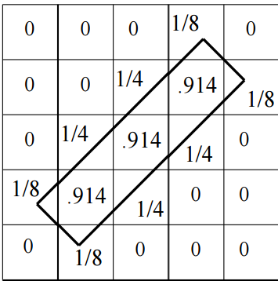
Unweighted Area Sampling
Primitive cannot affect intensity of pixel if it does not intersect the pixel.
Equal areas cause equal intensity, regardless of distance from pixel center to area.
Unweighted sampling colors two pixels identically when the primitive cuts the same area through the two pixels.
Intuitively, pixel cut through the center should be more heavily weighted than one cut along corner.

Slide 47
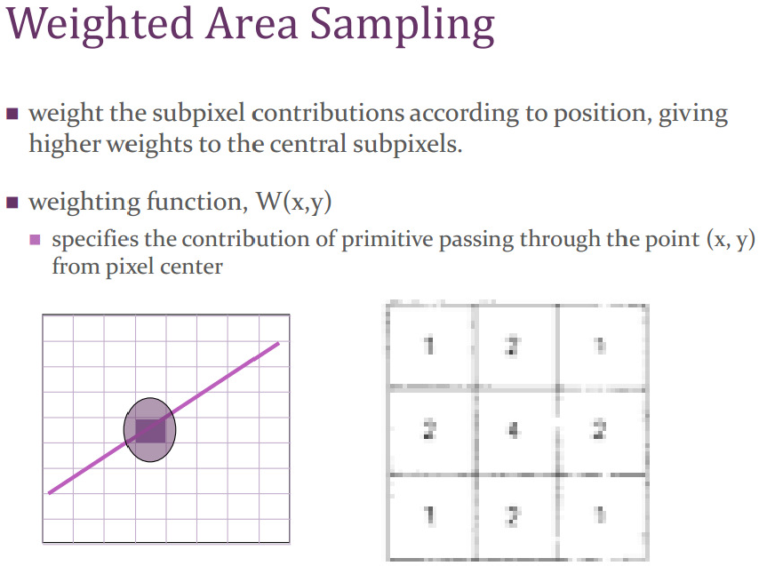

Slide 48
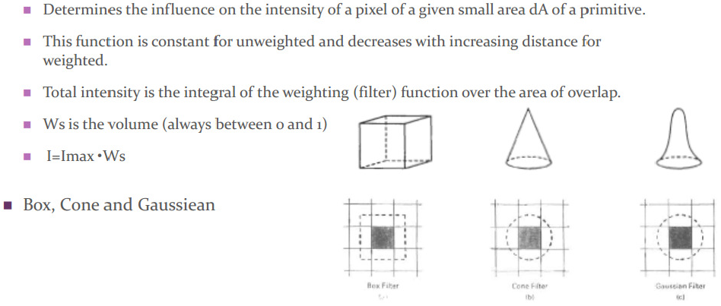
Filtering Techniques
A continuous weighting surface (or filter function) covering the pixel.
Applying the filter function by integrating over the pixel surface to obtain the weighted average intensity
Weighted (Filter ) Function

Slide 49
https://developerinsider.co/download-turbo-c-for-windows-7-8-8-1-and-windows-10-32-64-bit-full-screen/
developerinsider.in/turbocpp

